Slide 1

Eco Friendly, Energy Saving Street Light
Amit Krishna a

Slide 2
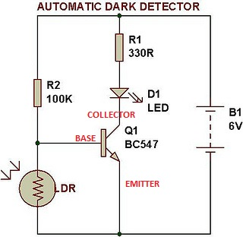
Exhibit 1: Automatic Light Detector
Light Dependent Resistor (LDR):
Resistance is HIGH when it is DARK
Resistance is LOW when it is BRIGHT
Light Emitting Diode (LED) is the STREET LIGHT
Transistor is the SWITCH
Voltage between BASE & EMITTER collector > 0.7V, SWITCH IS ON, Current flows through LED, Street Light is ON
Voltage between BASE & EMITTER collector < 0.7V, SWITCH IS OFF, No current flows through LED, Street Light is OFF
Voltage between BASE & EMITTER = (B1 * LDR)/ (LDR + R2)
ADVANTAGES:
Street Light is ON only when it is dark. Reduces wastage of Electricity
Automatic ON/OFF: No Electrician required to switch the light ON and OFF

Slide 3
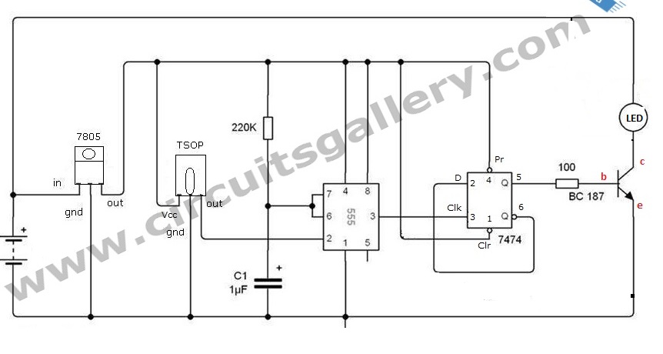
Exhibit 2: Infra Red Controlled Light Source (“Virtual Sun”)

Slide 4
Exhibit 2: Infra Red Controlled Light Source (“Virtual Sun”)
7805 – Voltage Regulator. Generates 5V from 9V battery
TSOP – Infra Red (IR) Light Sensor. Converts IR light to electrical voltage pulses
555 – Timer IC operating as Monostable Multivibrator
Converts many voltage pulses into single long voltage pulse
7474 – D FLIP FLOP to store “HIGH” or “LOW” voltage
TRANSISTOR – Current Amplifier to drive LED

Slide 5
References
www.circuitsgallery.com for the Exhibit 2 Circuit
www.buildcircuit.com for the Exhibit 1 Circuit
Wikipedia for circuit explanations

